Slide 1
SGNDP STEERING GROUP MEETING
20TH JANUARY 2016

Slide 2
Information gleaned from Paignton Development Forum's website "How to Join" page….
MEMBERSHIP
Membership is free and eligible to those who fit one of the following categories:
Resident in the area;
Work in the area;
Torbay Councillor (for SG NDP SG would this category therefore include District, Parish and County Councillors?);
Property owner in the area;
Retailer in the area;
Representative of a local organisation operating in the area.

Slide 3
Information gathered and how it is used:
collection of names/addresses,
the creation of a database,
the collection of information about interested organisations and skills.
Nothing explicit regarding the rights etc that come with membership (eg voting at meetings) though perhaps that is something that becomes apparent subsequently to applicants who achieve member status.
STATUS OF MEETINGS
With regard to members of the public and their attendance at meetings the only reference is the wording included on each Agenda -
"This is a meeting in public – all are invited and welcome to attend".
VOTING AT MEETINGS
Nothing explicit regarding voting at meetings; it seems likely that only those who have applied and become Members can vote.
There is a footnote regarding Privacy Policy.

Slide 4
SHDC LOCAL PLAN UPDATE
What can you do locally?
In addition to responding to consultation opportunities, there are other ways in which you can help shape the area in which you live.
Neighbourhood Planning
Many of our communities are already in the process of preparing Neighbourhood Plans. We have produced a new Neighbourhood Planning e-newsletter including information about the process, relationship with Our Plan: South Hams, and the support available. Please visit www.southhams.gov.uk/shneighbourhoodplans to view this e-newsletter. There is also lots of information on this page to look at if your community has not yet decided on whether to prepare a Neighbourhood Plan, but you wish to find out more. You will also need to speak to your Town/Parish Council as the body responsible for the preparation of any neighbourhood plan.

Slide 5
SHDC LOCAL PLAN UPDATE
Land availability
It has been two years since we commenced this exercise to help identify available land that could provide new homes and employment sites. We asked landowners and others to tell us what land may potentially be available for development. Over 200 submissions were made at this time and others have been received during the two year period.
These sites were assessed and interim results of the Land Availability Assessment were published in the summer of 2015. You can view the site information in the Parish Information Packs by visiting www.southhams.gov.uk/siteassessment. Additional sites that were submitted after this publication have been assessed and the results are also available via this link (but please note that these sites are not included on the site maps in the Parish Information Packs).
We are still looking to identify further land to ensure we have enough land to meet identified development needs of our communities. So, if there are other sites which have not been previously identified to the Council, or further extensions to existing ones, which are now available for development, we’d like to know more! We are particularly interested in sites within or close to settlements or sites that are well related to public transport routes, footpaths, cycleways and local facilities. It is important that development takes place in the right places with minimal impact on our environment. Please complete the response form and send this, with an OS based map clearly identifying the site.

Slide 6
CALL FOR SITES – NEW SITES SUBMITTED
SH_52_07_08/14 (New site submitted autumn 2014) | Four Cross Units, Lembury Road & Paignton Road, Stoke Gabriel
SH_52_08_14 (New site submitted autumn 2014) | South Hams Garden Centre and Land at Yellands Farm, Paignton Road, Stoke Gabriel
David Watts Comment : I understand South Hams DC have set a 12 month deadline to produce a new LP via joint working with Plymouth and other LPA's. If so, it will give the "objectively assessed need" (OAN) info required to comply with the NPPF in respect of the proposed NP and LP.

Slide 7
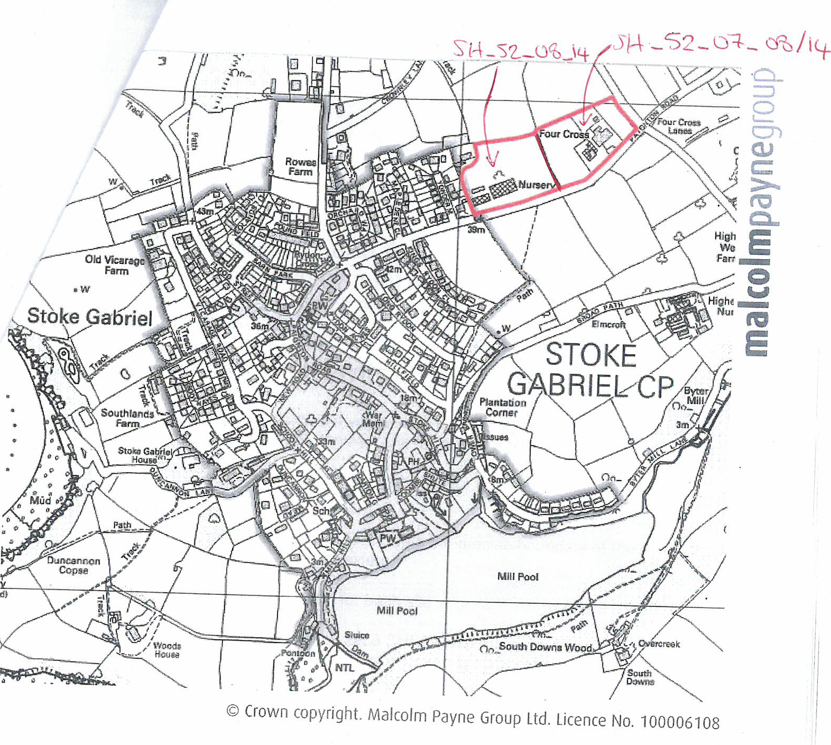

Slide 8
Upcoming Events:
Energy Event on Feb. 6th.,
and the
Paignton Neighbourhood Forum meeting on Jan. 21st.

Slide 9
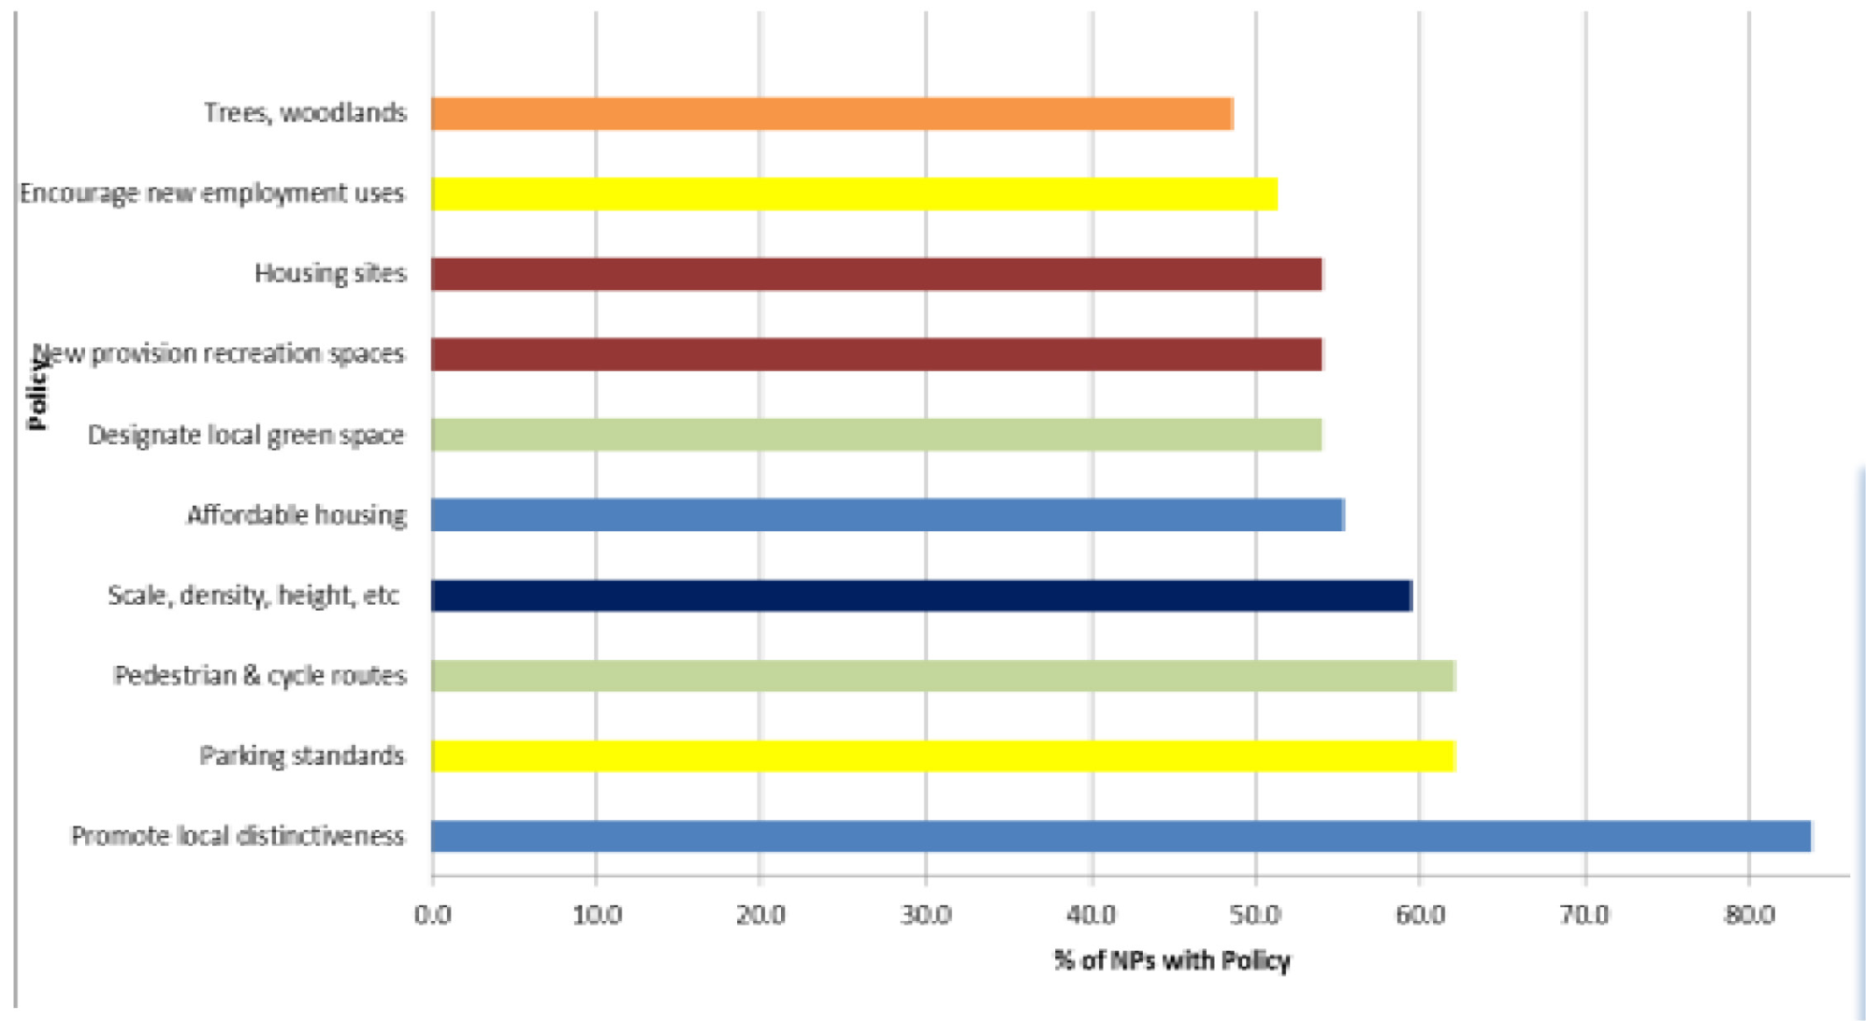
The chart shows the top 10 most popular policies, and the percentage of plans that contain them. Over 80% of neighbourhood plans contain a policy to promote local distinctiveness, while over half allocate housing sites

Slide 10
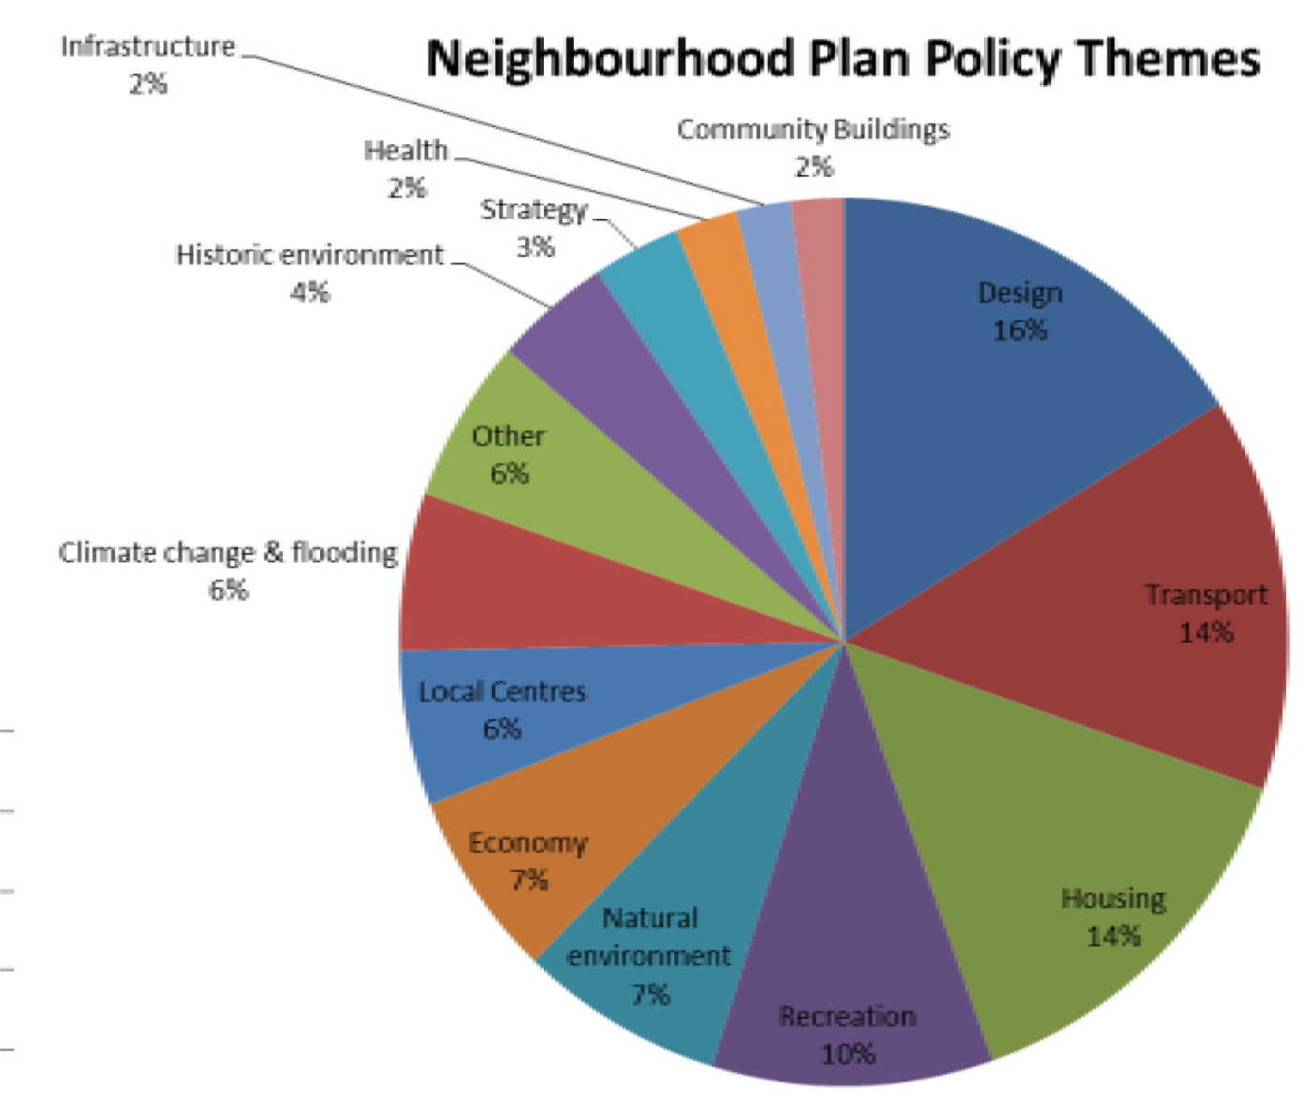
The pie chart relates to the wider themes that neighbourhood plan policies cover. Percentages relate to the number of policies devoted to each theme, as a proportion of the total number of policies in the 75 made plans. For example, 30% of all made neighbourhood planning policies are related to housing (14%) or design (16%)

Slide 11
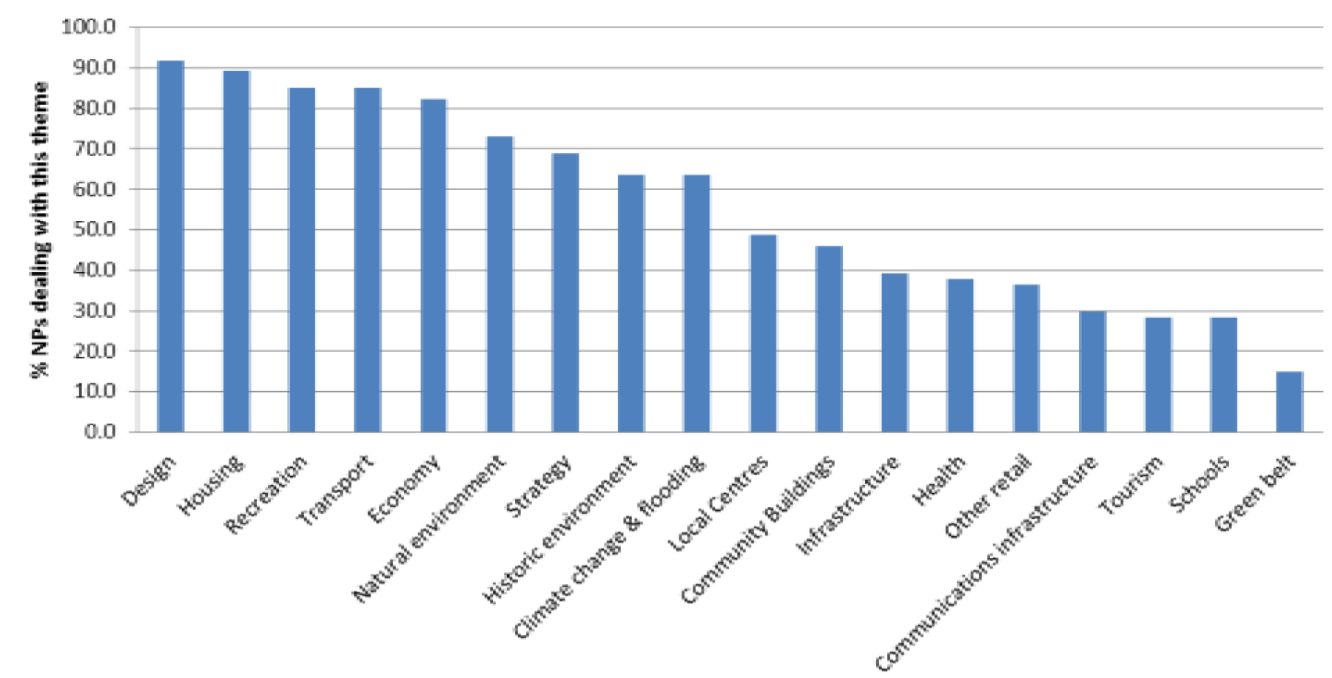
The below chart lists all of the wider themes by the percentage of neighbourhood plans which deal with them. Nearly 90% of neighbourhood plans contain at least one policy related to housing (such as site allocation, affordable housing or influencing the type, size and tenure) whereas over 80% cover built sport, leisure and recreation (such as allotments or sports pitches)

